Slide 1
ARDUINO BMP280
temperature, pressure, altitude sensor

Slide 2
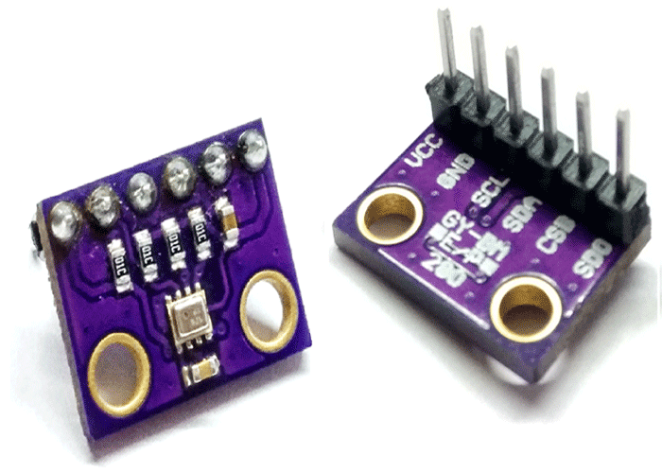
BMP280|Charasteristics
Measures Temperature, Barometric Pressure and Altitude
Communicates with Arduino via SPI or I2C protocol

Slide 3
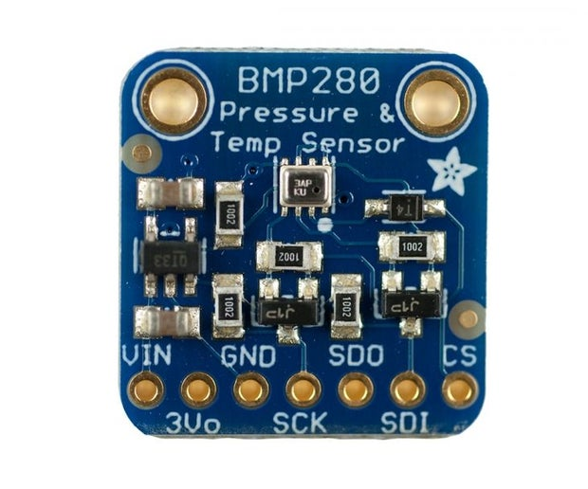
BMP280|Pinout
Pin 1: VIN, input voltage
Pin 2: 3Vo, 3.3V output voltage
Pin 3: GND, ground pin
Pin 4: SCK, Clock pin for SPI or I2C protocol
Pin 5: SDO, Serial Data Out for SPI protocol
Pin 6: SDI, Serial Data In, for SPI protocol, or data pin for I2C protocol
Pin 7: CS, Chip Select, for SPI protocol

Slide 4
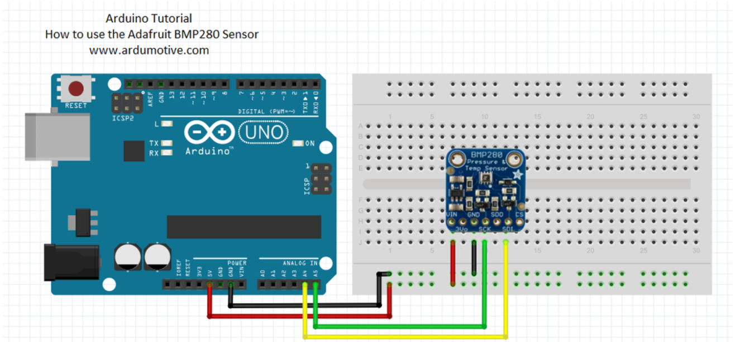
BMP280|I2C protocol connection
Pin 1: VIN on 5V
Pin 3: GND on Arduino GND
Pin 4: SCK on A5 pin
Pin 6: SDI on A4 pin

Slide 5
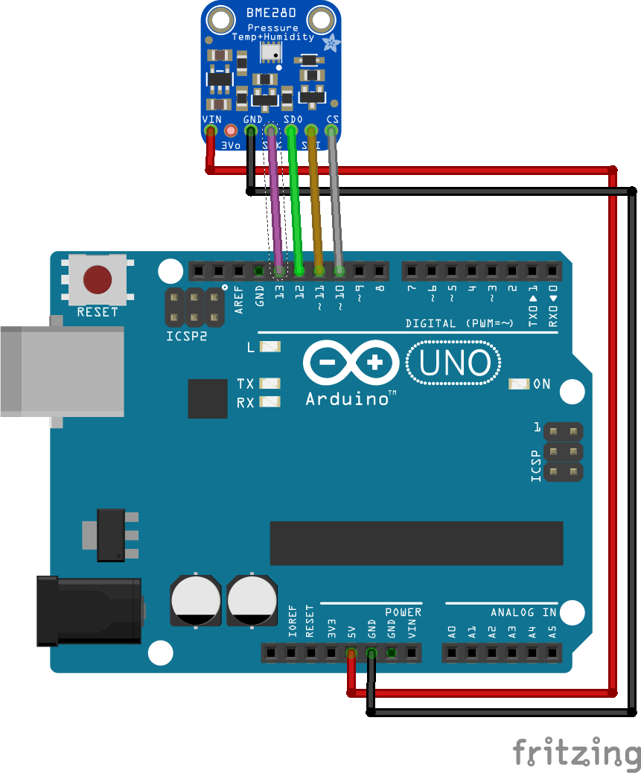
BMP280|SPI protocol connection
Pin 1: VIN on 5V
Pin 3: GND on Arduino GND
Pin 4: SCK on pin 13
Pin 5: SDO on pin 12
Pin 6: SDI on pin 11
Pin 3: CS on pin 10

Slide 6
BMP280|Libraries
Adafruit_BMP280.h: Contains all the useful functions to communicate with the sensor.
Download the library here.
This library uses other two libraries that are appropriate in the communication and must be installed.
Download these libraries from here.

Slide 7
BMP280|Basic functions
Create an object of a class Adafruit_BMP280: Adafruit_BMP280 bmp;
bmp.begin(): Start the communication with the sensor
bmp.setSampling(): Initialize parameters about the sampling times
bmp.readTemperature(): Returns the temperature value in Celcius
bmp.readPressure(): Returns the pressure value in 10*kPa
bmp.readAltitude(hPa): Returns the altitude pressure (hPa: atmospheric pressure in hPa).

Slide 8
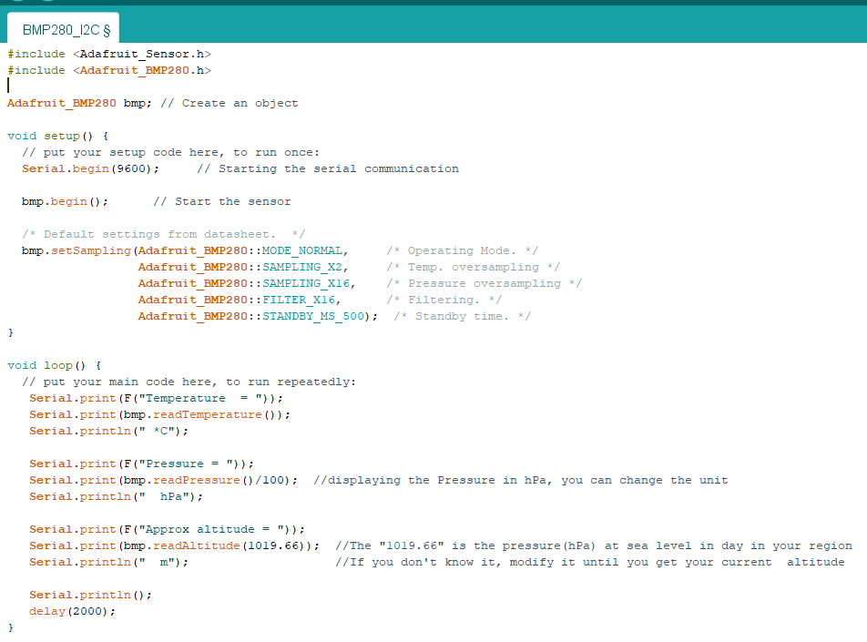
BMP280|I2C protocol code

Slide 9
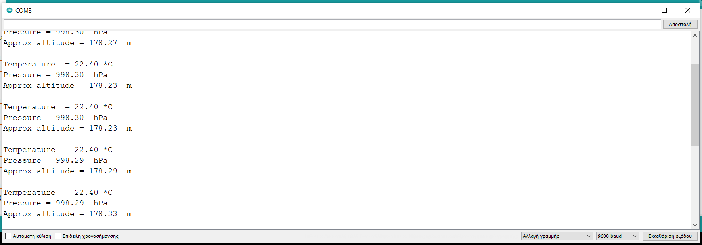
BMP280|I2C protocol results

Slide 10
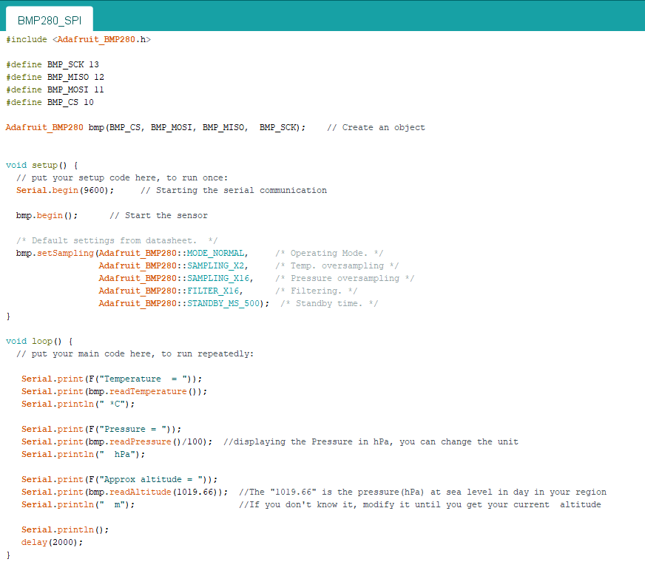
BMP280|SPI protocol code

Slide 11
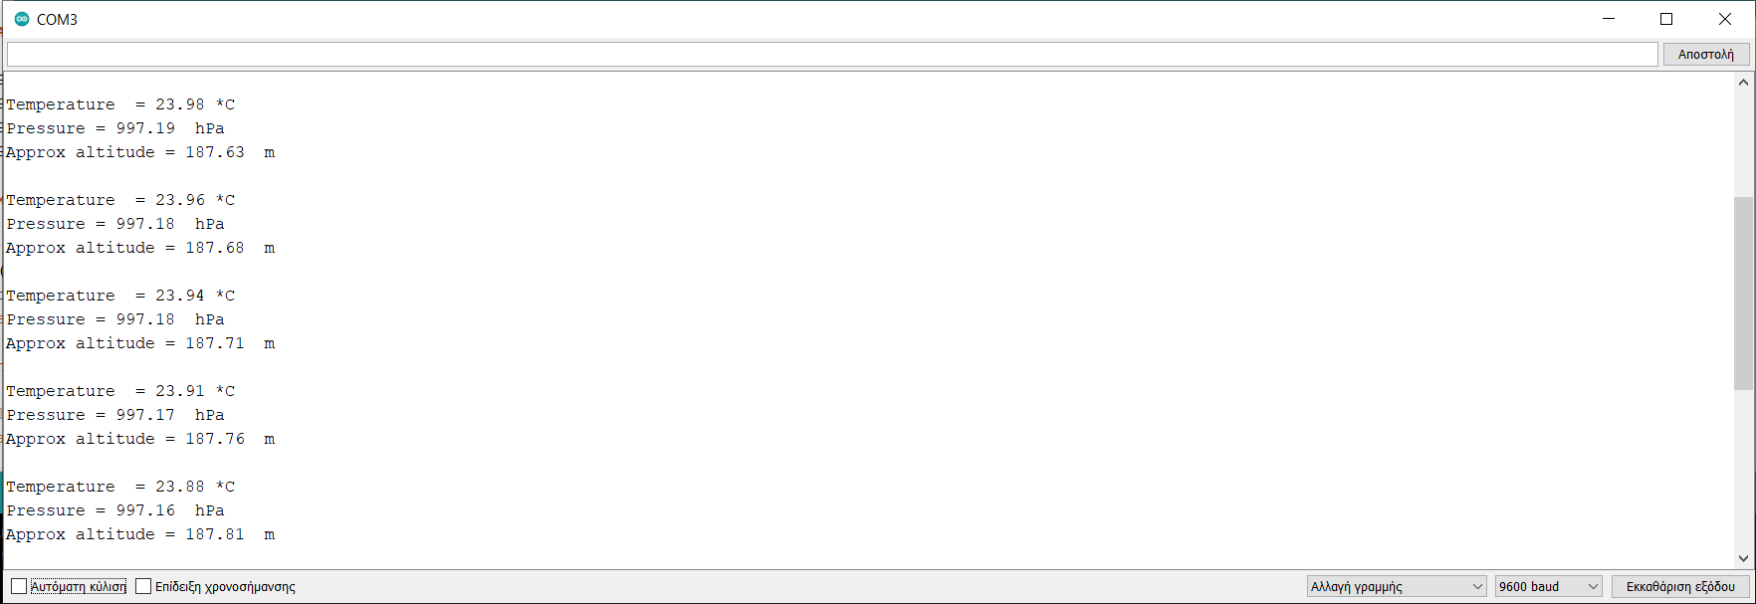
BMP280|SPI protocol results

Slide 12
BMP280|References-links
BMP280 in Arduino site: https://www.arduino.cc/reference/en/libraries/adafruit-bmp280-library/
BMP280 Library information from the constructor: https://github.com/adafruit/Adafruit_BMP280_Library
BMP280 My examples and the libraries in github: https://github.com/tzouv/BMP280_arduino_sensor

